Slide 1


MEDISPHERE
By
Sanjay Kumar S - RA2311026010321
S.Sanjay Siva - RA2311026010336
Course Name: DBMS
Course code: 21CSC205P
Faculty Name: Dr M. Manikandan

Slide 2

ABSTRACT
MediSphere is an advanced medical-based project leveraging the power of Large Language Models (LLMs) to revolutionize the healthcare domain. The system combines the capabilities of a Database Management System (DBMS) with LLMs to manage, analyze, and retrieve medical data efficiently. MediSphere provides a robust platform for healthcare professionals to store patient records, medical histories, diagnostic reports, and treatment plans in a secure and scalable database.
The project is designed to assist medical practitioners with features like symptom analysis, drug recommendations, medical report summarization, and trend analysis of diseases. With advanced capabilities, MediSphere enhances decision-making processes, reduces workload, and improves patient care outcomes. It ensures data privacy and compliance with healthcare standards, making it a reliable tool for modern healthcare systems. MediSphere represents a significant step toward integrating AI and DBMS for smarter, more efficient medical data management.

Slide 3

PROBLEM STATEMENT
Healthcare facilities often rely on multiple, disconnected software systems for patient management, medical records, billing, and administrative tasks. This leads to inefficiencies, data silos, and high operational complexity. Additionally, manual data entry is time-consuming, prone to errors, and inaccessible to individuals with low digital literacy. The challenge becomes even greater when migrating from legacy systems, as data transfer is often complicated and error-prone.

Slide 4

TECHNICAL STACK USED
1️⃣ Backend (Server & Database Management)
🔹 Python (Flask) – Web framework for handling API requests, authentication, and business logic.
🔹 MySQL – Relational database for storing patient records, appointments, and hospital data.
🔹 SQLAlchemy – ORM for interacting with MySQL using Python objects, making database management easier and safer.
2️⃣ AI & Machine Learning (Automation & Assistance)
🔹 DeepSeek R1 – AI model for reasoning, automation, and smart hospital management.
🔹 OpenAI Whisper – Speech-to-text model for voice-based patient registration and data entry.
3️⃣ No-Code / Low-Code UI (User Interface for Easy Access)
🔹 Streamlit – Interactive web UI for hospital dashboards and management panels.
🔹 Gradio – AI-powered UI for speech-based patient registration and voice input.
4️⃣ Data Handling & Migration (Effortless Data Transfer & Processing)
🔹 Pandas & NumPy – Used for cleaning, processing, and migrating hospital data.
🔹 Flask-Migrate – Handles database schema changes smoothly without data loss.

Slide 5
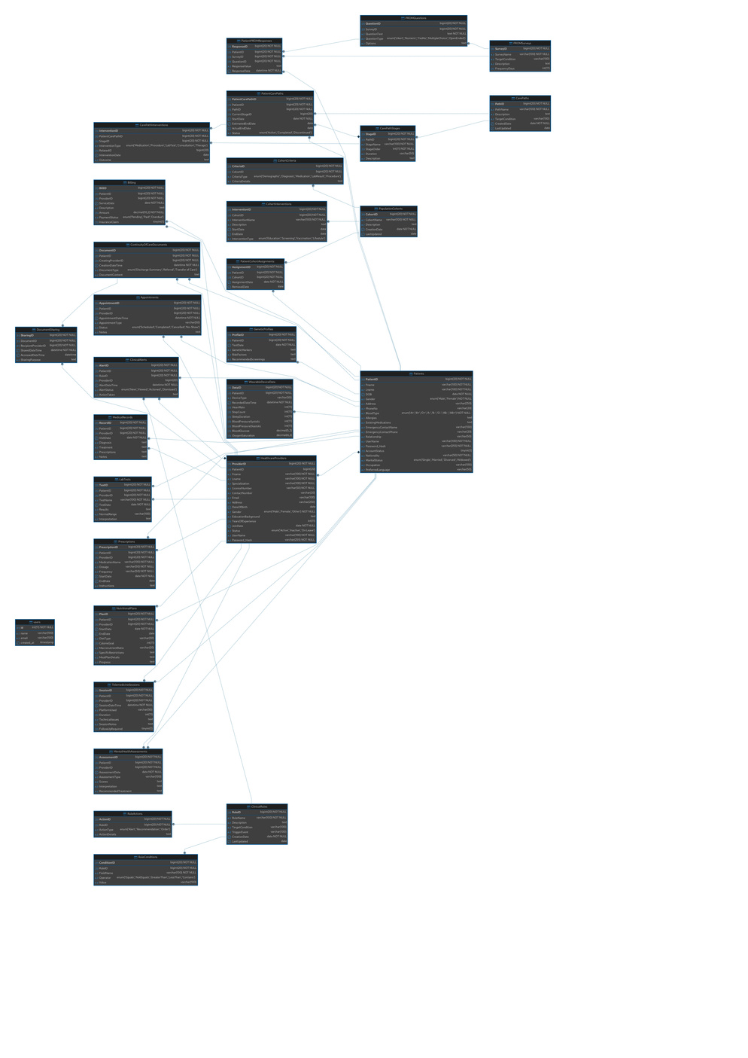
OBJECT ORIENTED E-R DIAGRAM
E-R DIAGRAM

Slide 6
Backend Architecture Diagram
User (Doctor/Nurse/Admin)
Frontend UI (Streamlit / Gradio)
MySQL Database
Flask API Layer(Request Handling, Business Logic)
Security(JWT, Role-Based Access, Encryption)
AI Services
Deployment(Docker, Gunicorn, Nginx, Cloud Hosting)
DeepSeek R1(AI Diagnosis, Summarization)
SQLAlchemy ORM
Data Processing(Pandas, NumPy, Migration)
Whisper(Sp eech-to-Text)

Slide 7
MODULES
✅ User Management Module – Manages authentication, role-based access for doctors, patients, and administrators.
✅ Patient Management Module – Handles patient registration, medical history, and profile management.
✅ Doctor Management Module – Manages doctor profiles, schedules, prescriptions, and treatment plans.
✅ Appointment Scheduling Module – Enables patients to book, reschedule, and cancel appointments based on doctor availability.
✅ Billing & Payment Module – Automates bill generation, payment processing, and insurance claim handling.
✅ Inventory & Pharmacy Management Module – Tracks medicine stock, orders, and supplier management.
✅ AI-Based Medical Assistance Module (Optional) – Provides AI-driven symptom analysis and diagnosis suggestions.
✅ Reports & Analytics Module – Generates insights, hospital performance reports, and patient statistics.
✅ Security & Compliance Module – Ensures data security, encryption, and compliance with regulations (HIPAA, GDPR).
These modules work together to create an efficient, AI-integrated hospital management system, improving healthcare services and administrative operations.

Slide 8
CONCLUSION
The Unified Hospital Management System is a comprehensive and AI-powered solution designed to streamline hospital operations, from patient registration to medical record management, AI-driven diagnosis, and seamless data migration. By integrating modern technologies like Flask, MySQL, SQLAlchemy ORM, and AI models such as DeepSeek R1 and Whisper, the system enhances efficiency, security, and accessibility for healthcare professionals and patients alike.
The incorporation of no-code/low-code UI frameworks ensures ease of use, making the system inclusive even for non-technical users. The AI-powered speech-to-text integration further simplifies data entry, enabling hospitals to serve a broader demographic, including illiterate or differently-abled individuals.
Additionally, with Docker, Gunicorn, and Nginx-based deployment, the system ensures scalability, high availability, and security, making it a robust, future-ready hospital management platform. The use of structured database management and AI-driven automation significantly reduces manual workload, improves accuracy, and enhances patient care quality.
Overall, this project represents a technological leap in healthcare management, making hospital administration more efficient, cost-effective, and patient-friendly while setting a foundation for future AI innovations in the medical field. 🚀

Slide 9
THANK YOU!

